Slide 1

Noah Heath
Starting Pitching Report
Cole Thomas 6/17/26 vs Breakers

Slide 2
Final Line
Appearance number | Season Innings | IP | ER | R | H | HBP | BB | K | BF | NP | Season ERA | Season WHIP
2 | 8.1 | 4.0 | 6 | 6 | 9 | 0 | 1 | 8 | 22 | 88 | 7.56 | 2.28

Slide 3
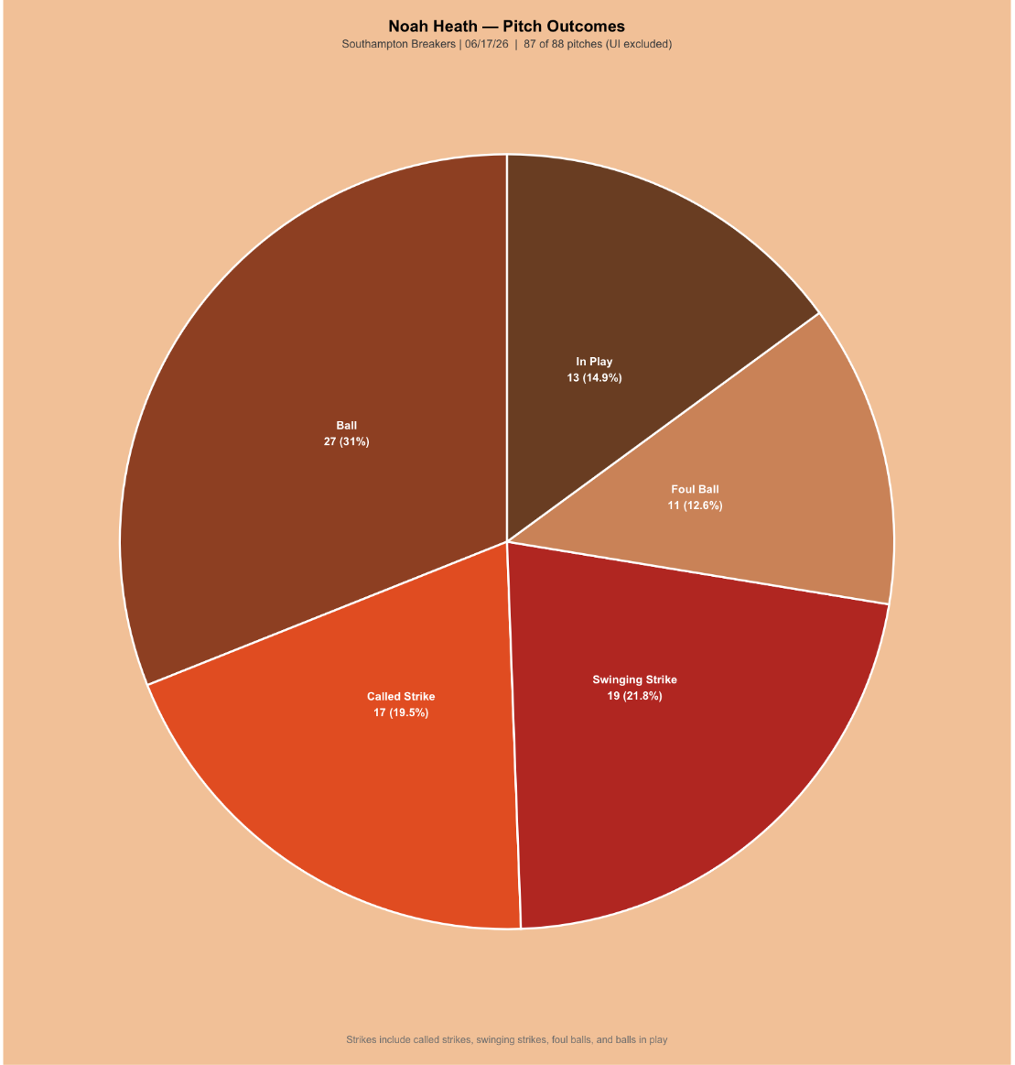
Pitch Outcomes
In general, Heath was in the strike zone a decent amount, with around a 70% strike rate. He also was able to get a decent number of swing and misses with 19 swinging strikes going against 17 called strikes, which makes sense considering he has 8 strikeouts in just 4 innings.

Slide 4
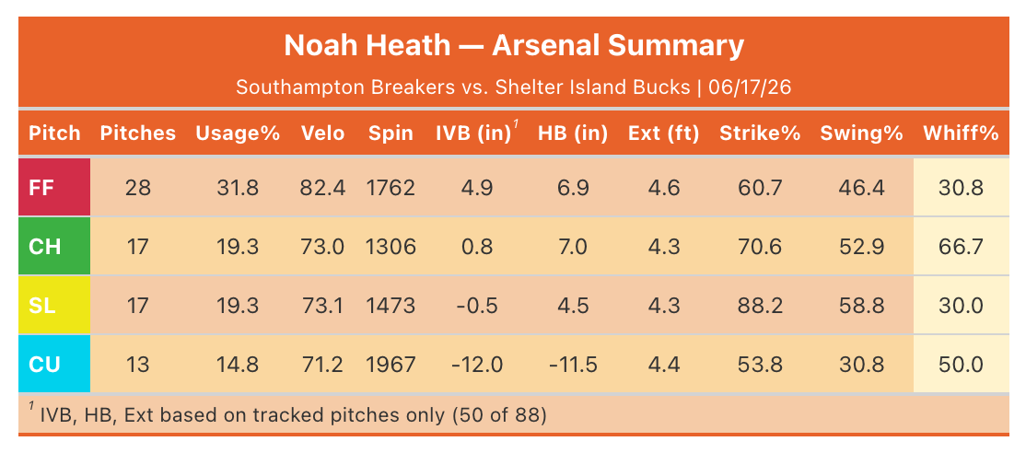
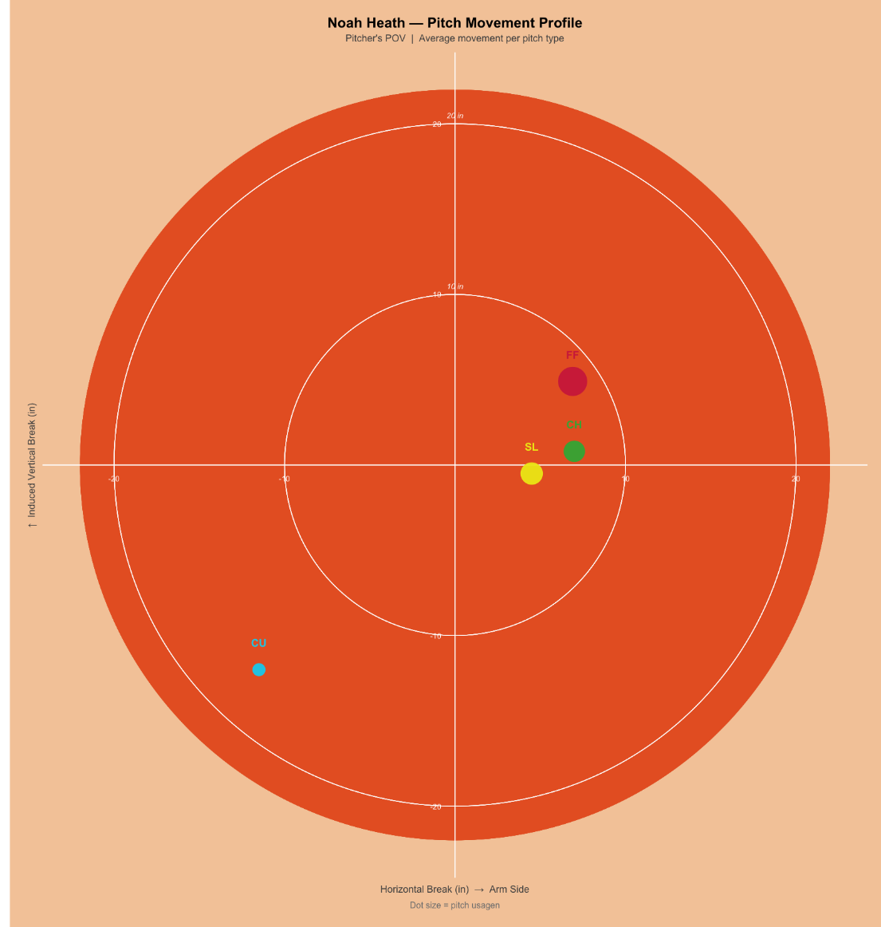
Pitch Arsenal
Heath has a 4 pitch mix of a 4-seam fastball, changeup, slider and curveball. Of his offspeed, his change-up was most effective at generating swings and misses this outing, with a whiff rate of 66.7%. The slider and change-up have very similar metrics, but the change up seems to be more effective at missing bats likely because of its closer resemblance to his fastball.
*13 of 88 pitches were either tagged as Unidentified and excluded from this

Slide 5
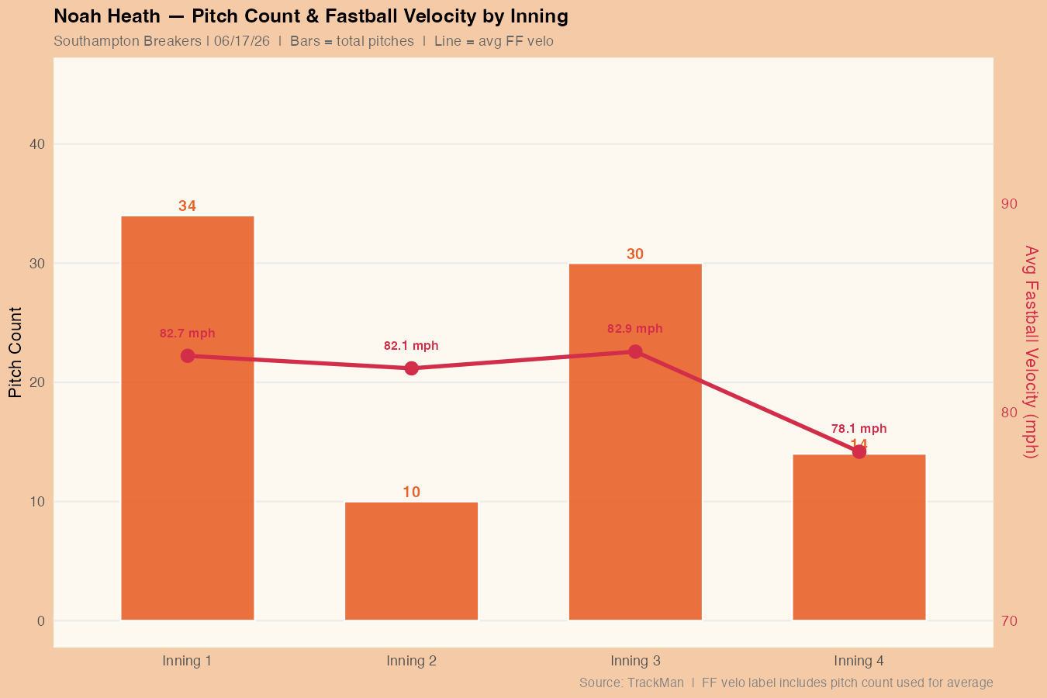
Pitch Count & Fastball Velo
In this chart, you can see that after a rough 3rd inning where he gave up 4 runs and 2 home runs over 30 pitches, Heath’s fastball velocity dropped from about 82 mph to about 78 mph. This was after around his 75th pitch which may serve as a good soft cap for him going forward as a point he starts to fatigue.

Slide 6
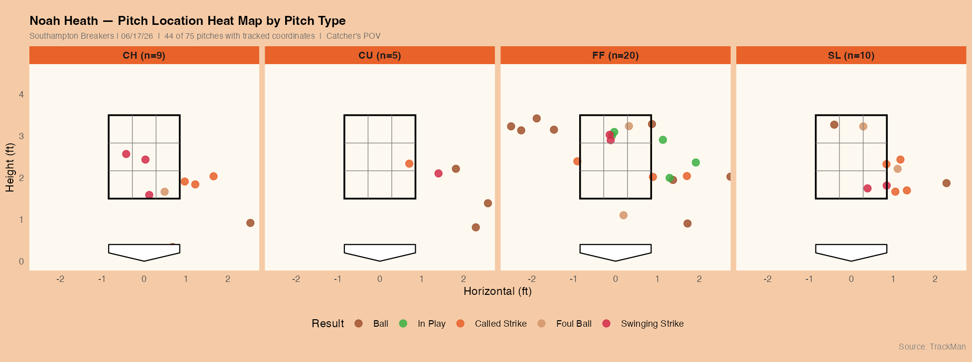
Pitch Location
When looking at Heath’s pitch location, it stands out that almost all his breaking pitches are clustered near the first base side of home plate. While this could mean he is tunneling and using pitches off each other well, if he could find a pitch that is effective on the other side of the plate it would allow him to diversify his attack more and be flexible in his approach. Overall though, he did a nice job of avoiding the heart of the plate with only one pitch being located in the middle-middle section, but needs to be closer to the zone with his fastball misses, as too many were uncompetitive

Slide 7
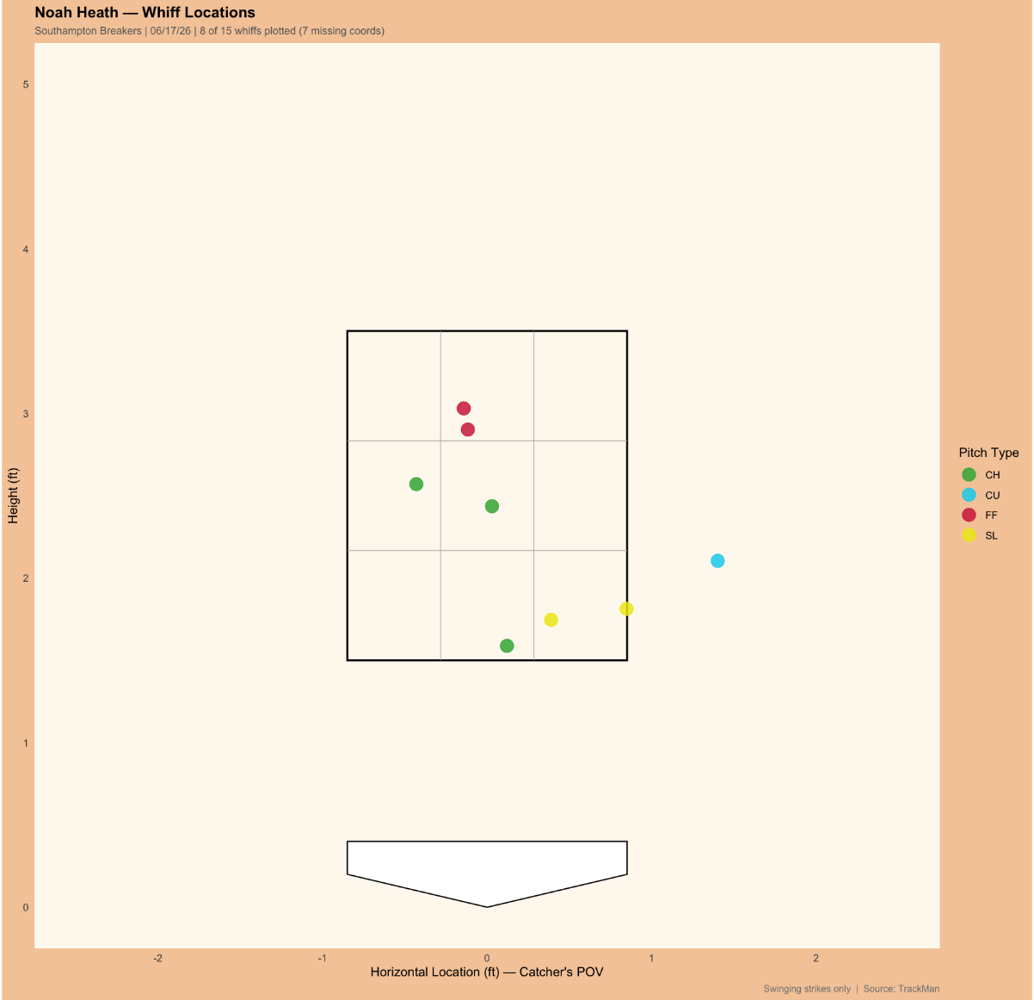
Whiff Location
Looking at the location/pitch type of Heath’s swing and misses, a few things stand out:
7 of 8 tagged whiffs were inside the strike zone, could be struggling to get guys to chase
Only swing and miss outside the zone was a curveball
Fastball whiffs came at the top of the zone, changeup and slider were more effective when located lower in the zone
*7 of 15 whiffs are missing location tags and cannot be used for this

Slide 8
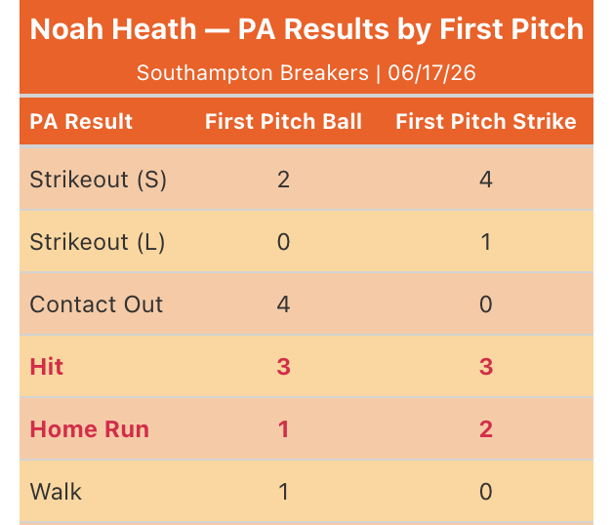
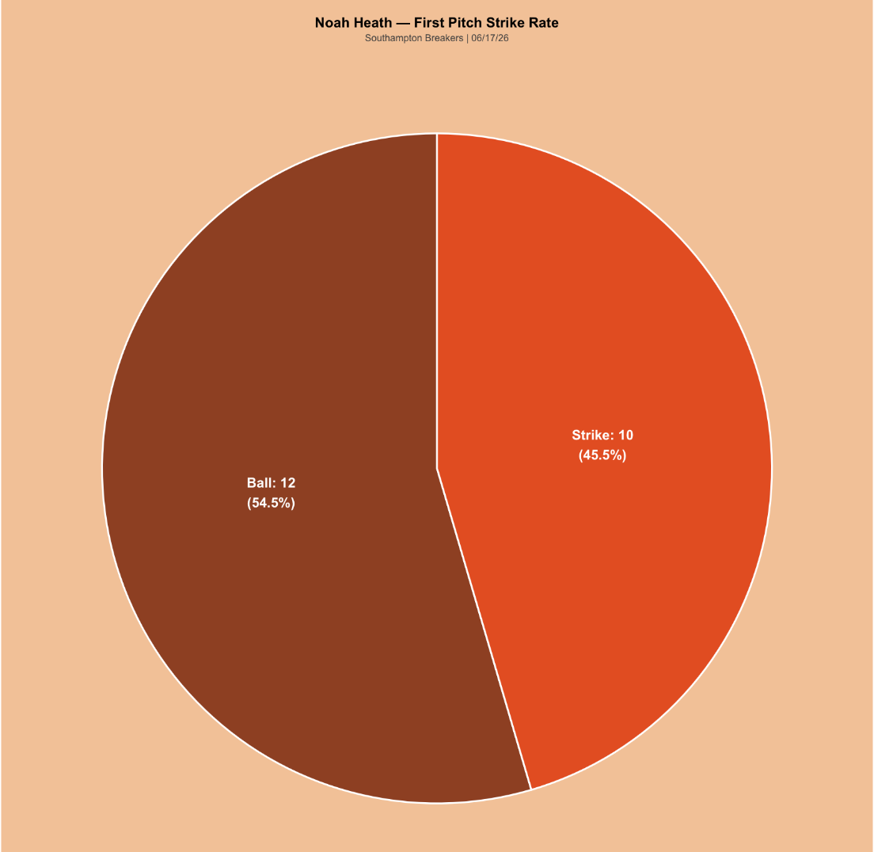
First Pitch
*1 at-bat had an unknown result, was a first pitch ball
Heath was not great at getting ahead in counts in this game with 12 of his 22 at-bats beginning with a ball. This was most impactful when looking at his strikeout results. When he threw a first pitch strike, he struck the batter out 50% of the time, compared to just 16.67% when throwing a first pitch ball

Slide 9
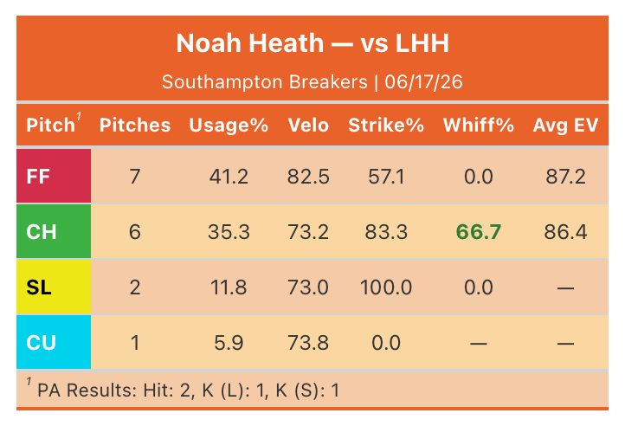
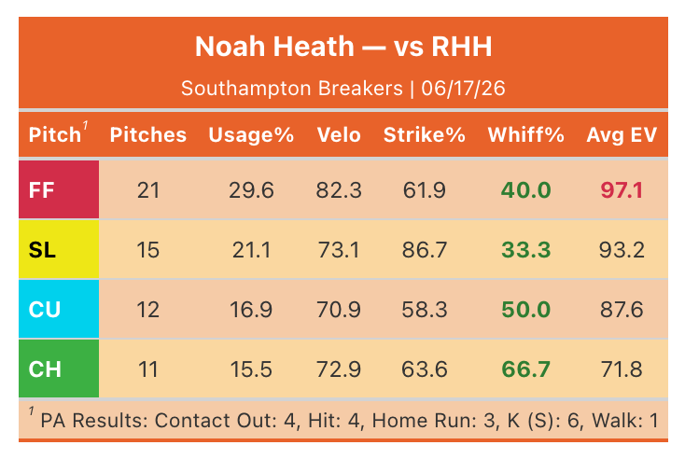
LHH vs RHH Pitch Mix/Results
Overall, in this start, Heath’s pitches were more effective against lefties compared to righties. Although he did give up 2 hits in 4 ABs against lefties, he allowed much softer contact, specifically off of his fastball. His slider was not very effective when thrown to righties, as it had the lowest whiff rate of any pitch and was also being hit very hard.

Slide 10
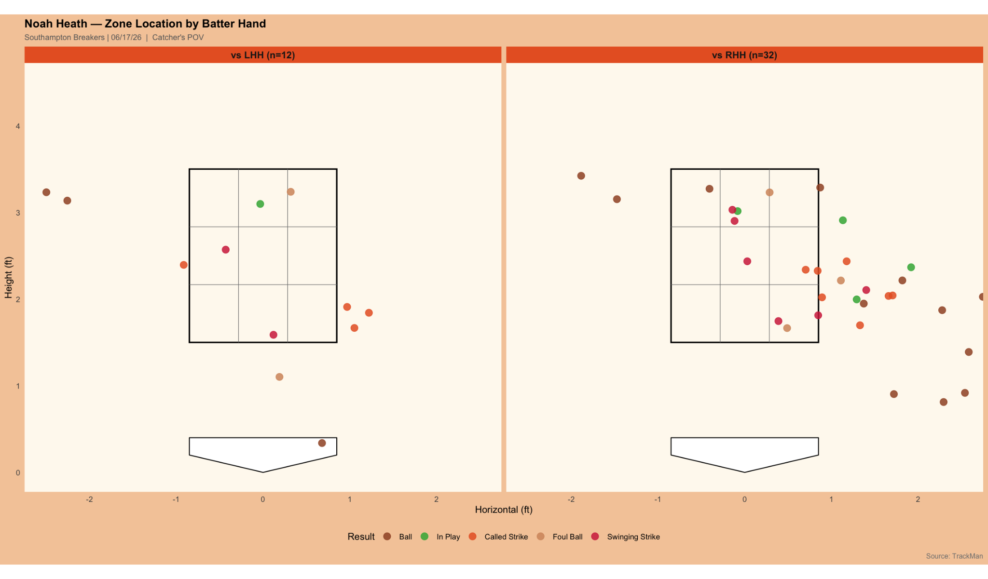
LHH vs RHH Zone Location
When looking at his pitch location between LHH and RHH, you can see why he was more effective against lefties. He was able to stay more in and around the zone to these guys and was rewarded by getting a lot of corner pitches called strikes.

Slide 11
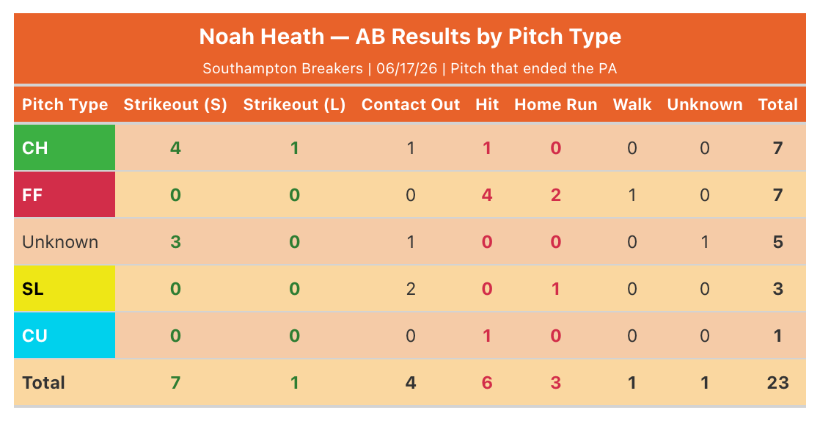
Pitch Results
Heath’s change-up stands out as his best pitch on the day getting him 5 of his 8 strikeouts (the other 3 were on untagged pitches).
His fastball was the pitch that hitters were taking advantage of, with 6 of 9 total hits and 2 of the 3 home runs coming off his fastball.

Slide 12
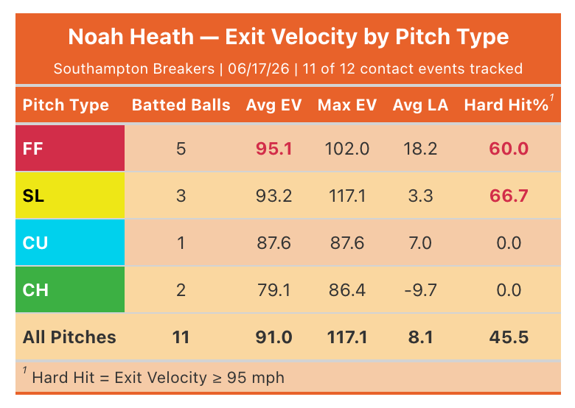
Exit Velocities
A couple things stand out when looking at the batted ball data on each of Heath’s pitches:
Fastball and Slider were both being hit very hard and in the air; this is a recipe for damage.
Changeup has the lowest average exit velo and was constantly being hit on the ground

Slide 13
Summary
Heath had an up and down start, was able to get a lot of strikeouts (8K in 4.0 IP), but was also hit around a lot and gave up 3 HRs, ultimately resulting in a 10-0 Bucks loss.
Changeup emerging as an effective swing and miss pitch that works well off of 4-seam fastball, might want to throw more of it compared to relatively similar and more ineffective slider. Would lead to a diverse and effective three pitch mix of fastball, curveball and changeup.
Heath was more effective when pitching to lefties because he was able to stay around the zone and not give away uncompetitive pitches. He also threw his slider less which proved to be an effective strategy
Could try out a new pitch with glove side horizontal movement (Cutter/Sweeper) that could be an effective counter to the change-up and utilize the third-base side of the plate.
Changeup also stood out as an effective weak contact pitch, especially compared to fastball and slider, this reinforces the idea that the slider serves little purpose and can be replaced by more changeups.
Struggled to constantly get ahead of first-pitches, when he did get ahead it was beneficial to him as he tended to finish off hitters well with strikeouts.

